Slide 1

Logistic Regression for Loan Prediction
Eli Dalton

Slide 2

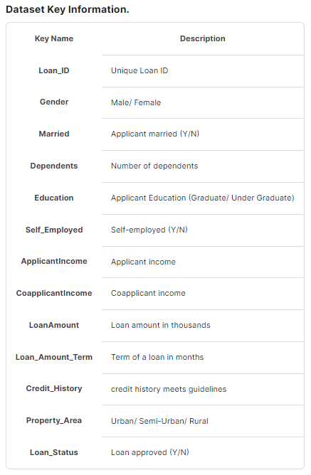
Picking the Dataset
Dream Housing Finance company
Deals in all home loans
Customer eligibility already validated
Why I chose it?
Accounting background
Internship experience with consumer loans

Slide 3
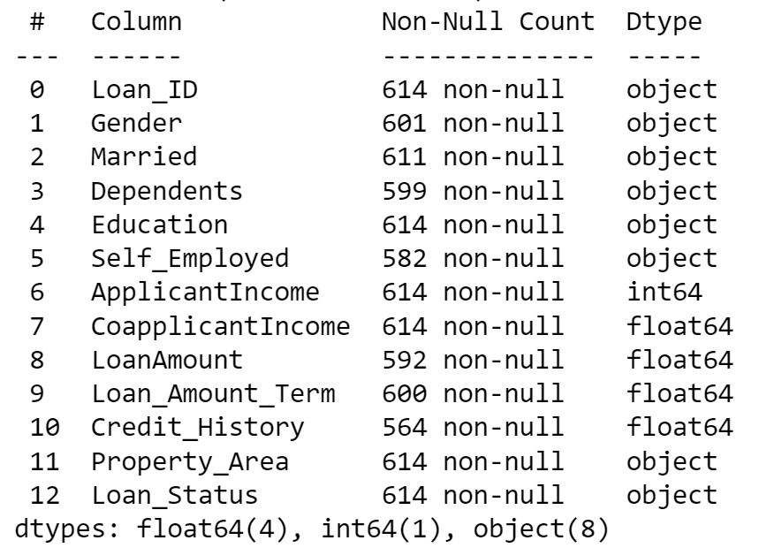
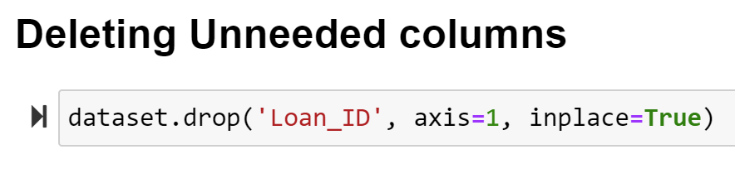
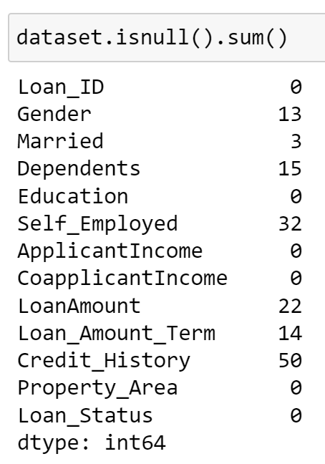
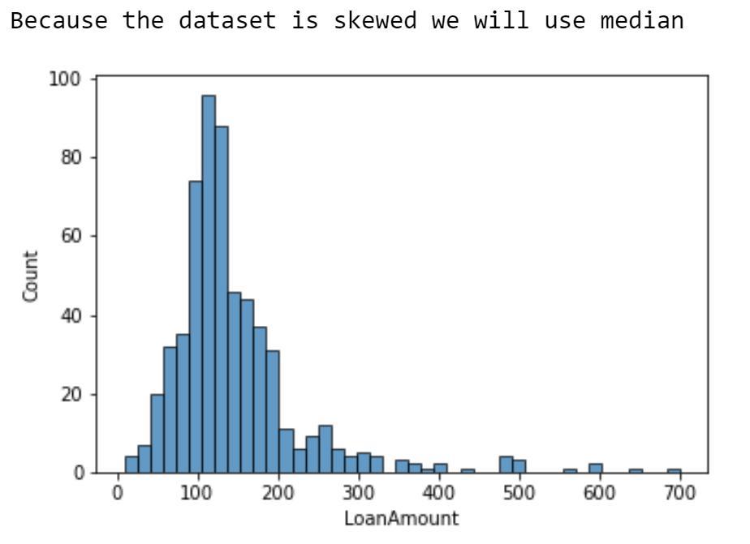
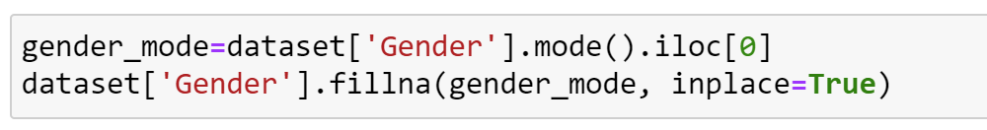
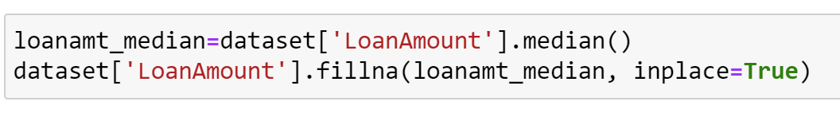
Purpose and First Steps
Create a functioning logistic regression model using machine learning with a dataset of choice
Predict Loan Approval
Data Preprocessing:
Categorical
Numerical

Slide 4
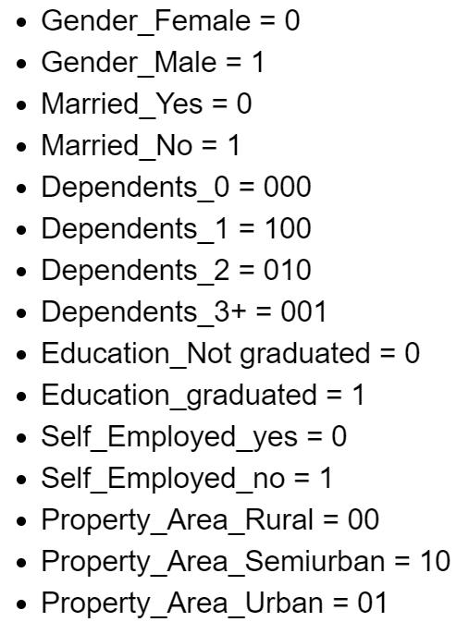
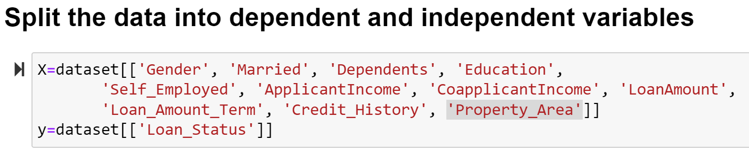
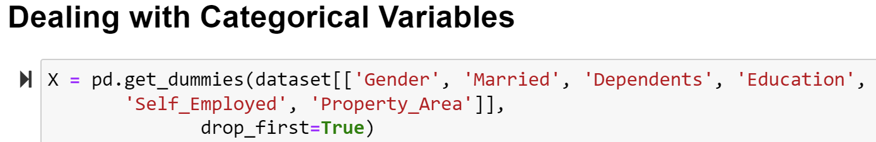
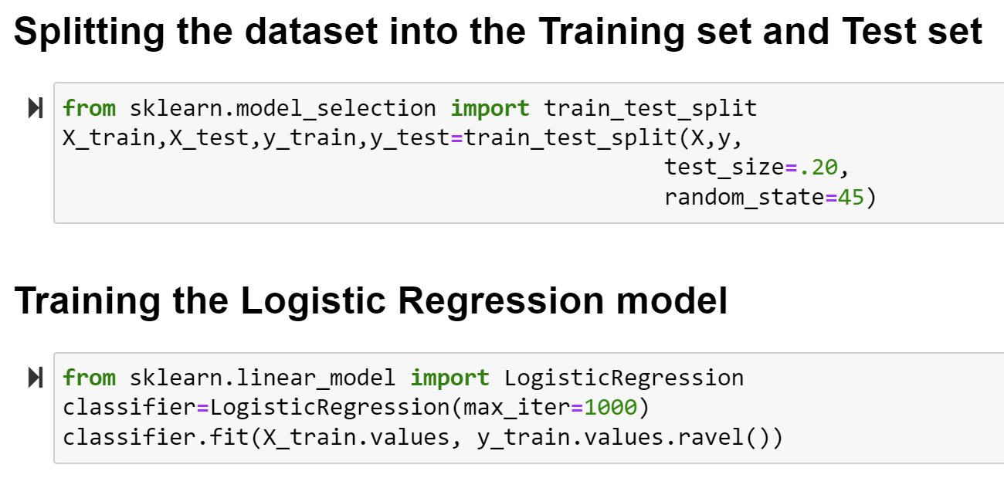
Design & Implementation
1
3
2
4

Slide 5
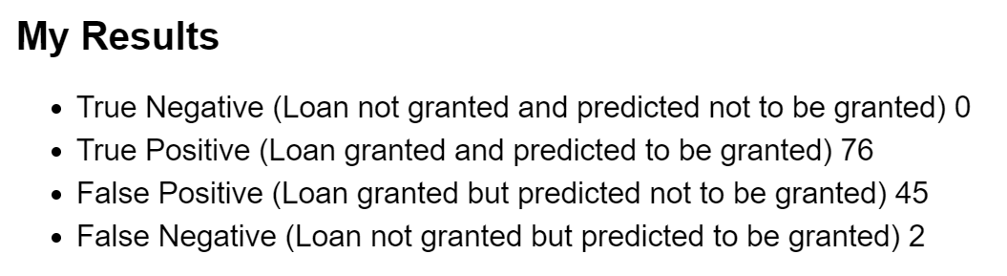
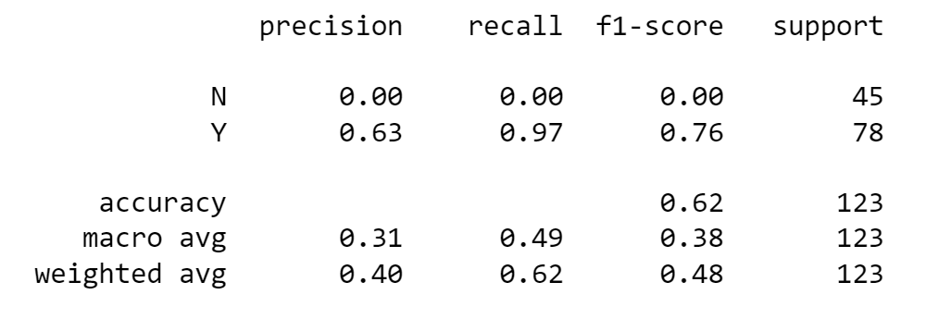
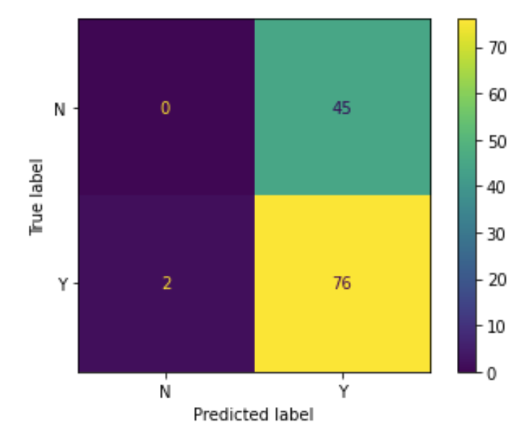
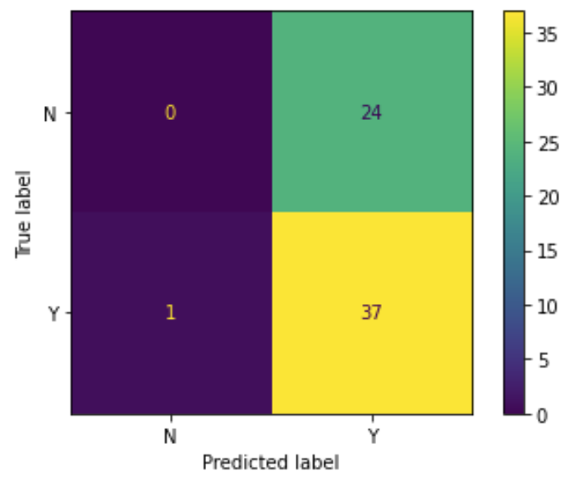
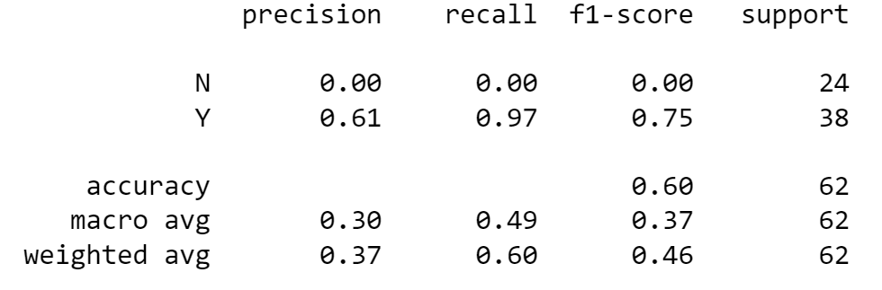
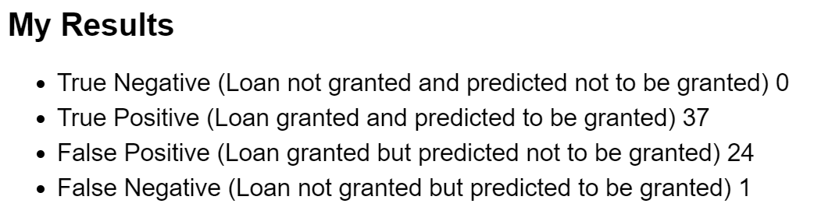
Results
Experiment #1:
Train set = 80%
Test set = 20%
Random state = 45
Experiment #2:
Train set = 90%
Test set = 10%
Random state = 45

Slide 6
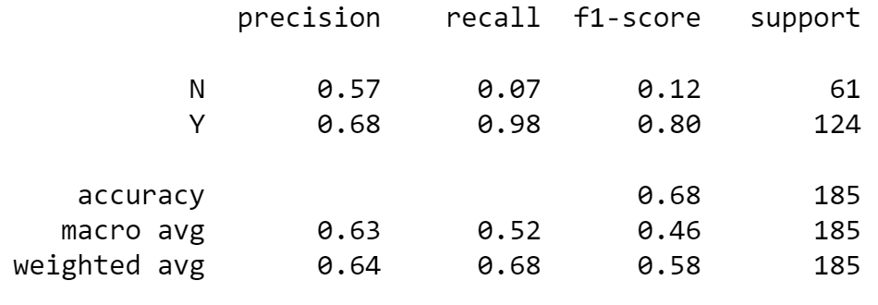
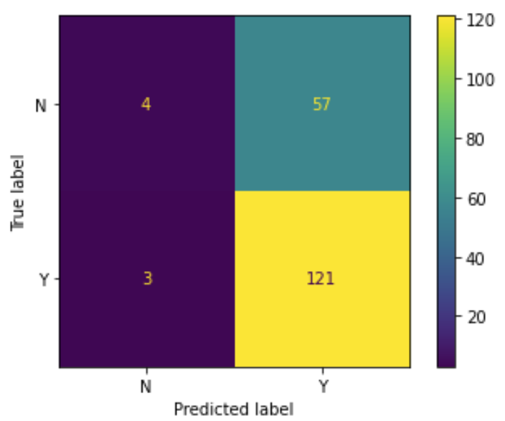
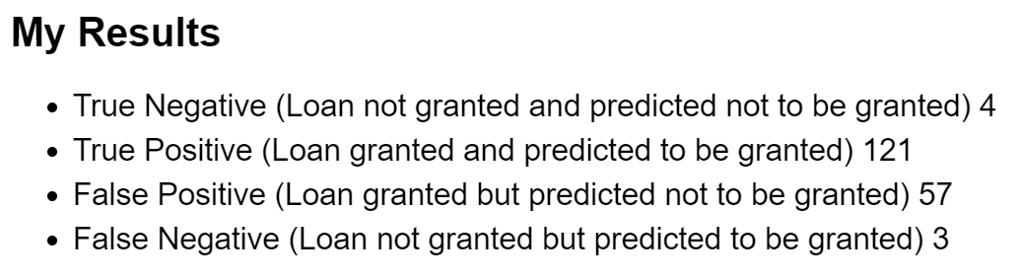
Results
Experiment #3:
Train set = 70%
Test set = 30%
Random state = 45
Conclusion:
Not a great model
Definitely needs more adjusting before it could be used

Slide 7
Thank you for Listening!
Any Questions??

